Slide 1

Decoding disk
Theme DNA
Book 2, Scientific Breakthroughs in the Classroom!

Slide 2
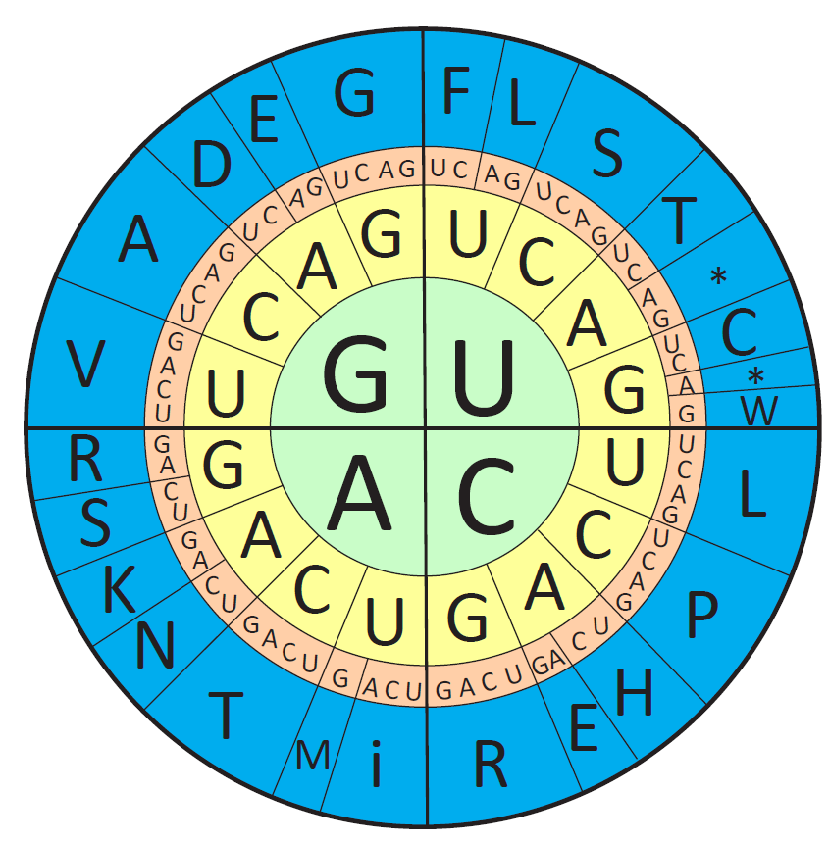
Decoding disk

Slide 3
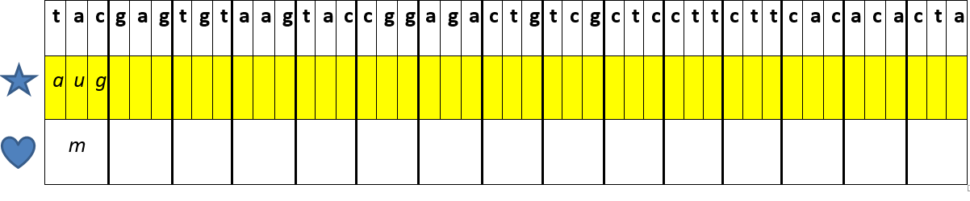
Decoding disk
You have a DNA strand
Write the correct letters next to the star.
Think of the rules:
A always gets a U
C always gets a G
G always gets a C
T always gets an A

Slide 4
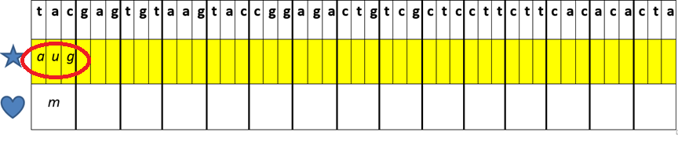
Decoding disk
You are now going to look for the correct letter for this code in the decoding disk.

Slide 5
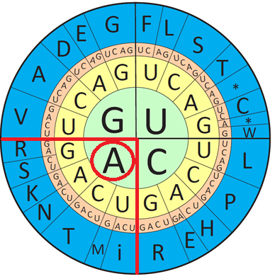
Decoding disk
We are looking for the correct letter for the code AUG.
You always have to find the first letter in the middle (green).
The first letter is the A.

Slide 6
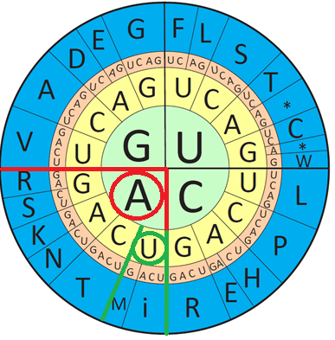
Decoding disk
We are looking for the correct letter for the code AUG.
You find the second letter in the yellow margin.
The second letter is the U.

Slide 7
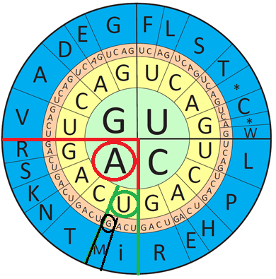
Decoding disk
We are looking for the correct letter for the code AUG.
You find the third letter in the orange margin.
The third letter is now the G.

Slide 8
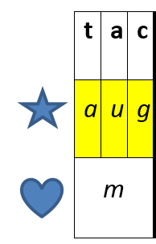
Decoding disk
So to the code AUG belongs the letter M (blue margin).

