Slide 1
HEARING

Slide 2
EXPLANATION
In a moment, you will hear two sounds and see two images.
Try to associate the sounds with the images. Which sound fits with each image?
Indicate your choice on the answer sheet!
Press enter when ready to begin.

Slide 3

Click on the speaker icon to play the recording.
Example:

Slide 4
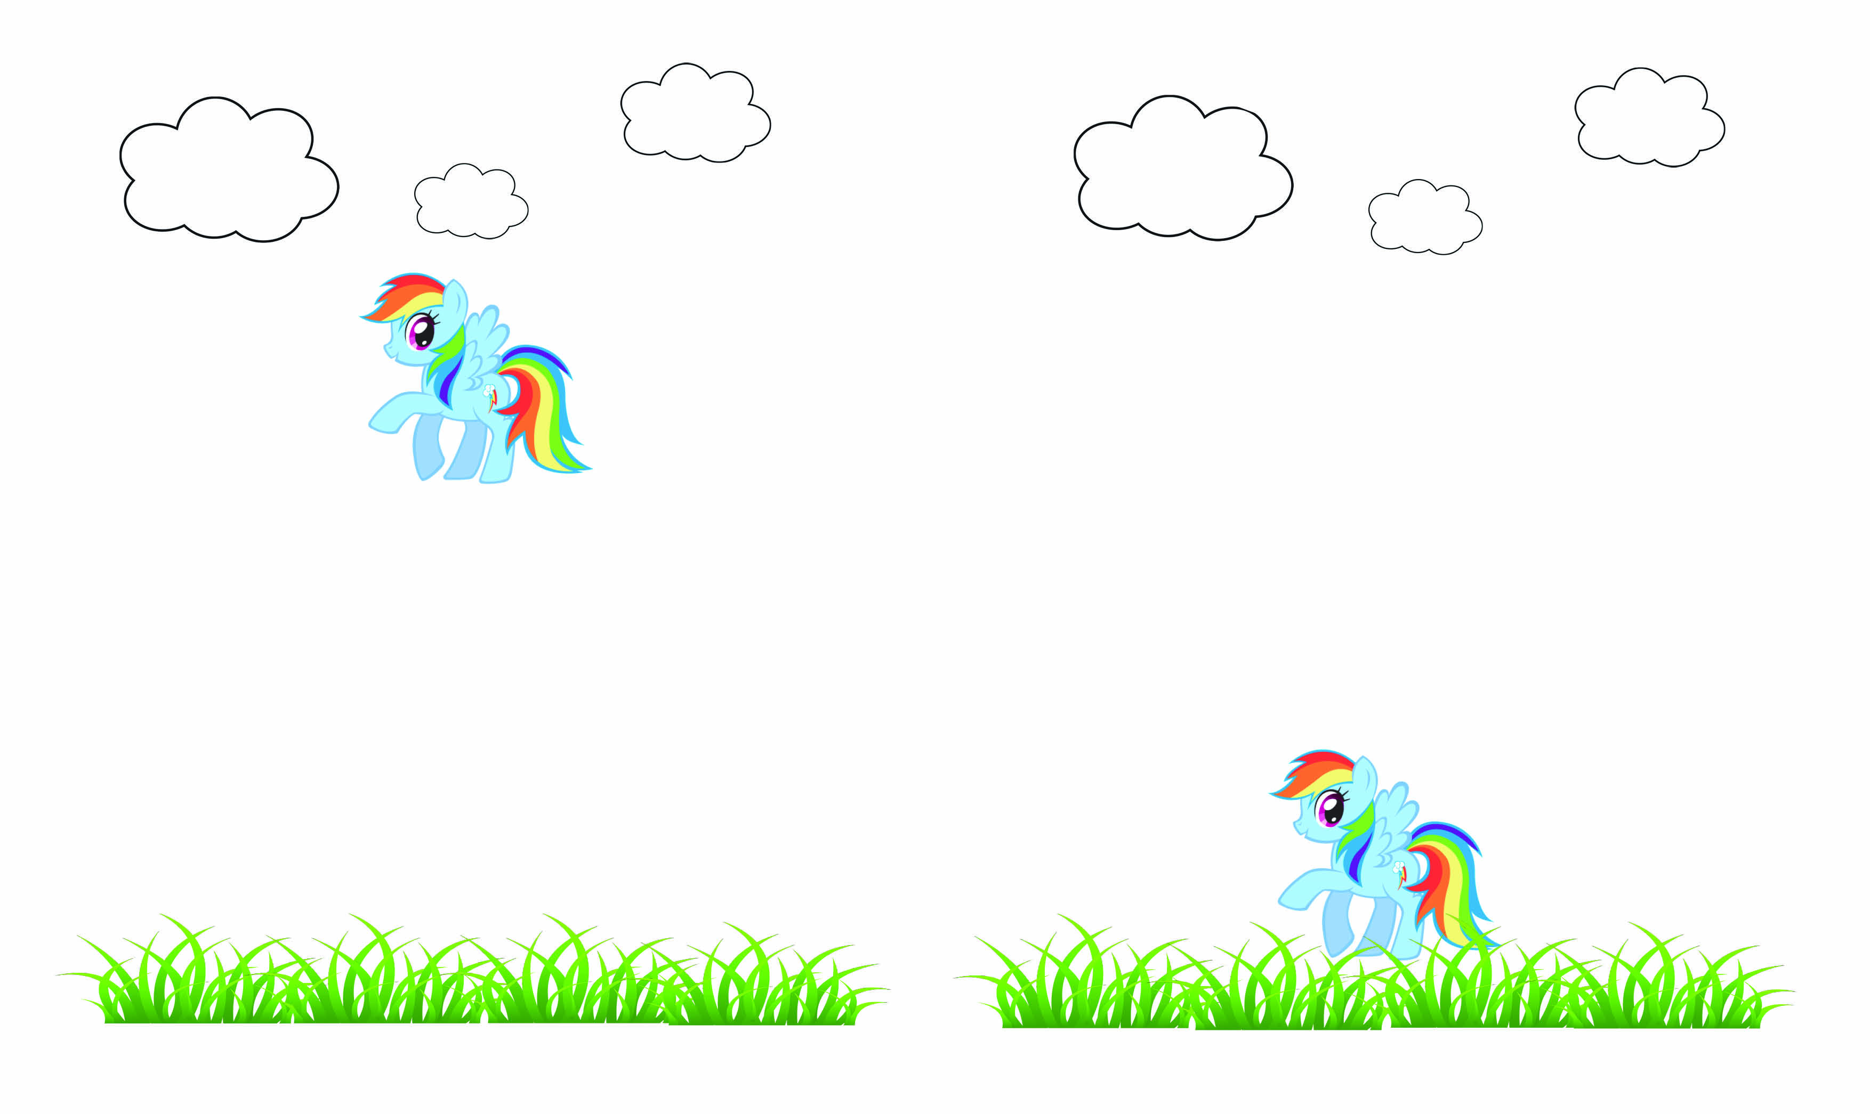
1)
SOUND 1:
SOUND 2:

Slide 5
Which image belongs to SOUND 1?
Which image belongs to SOUND 2?

Slide 6
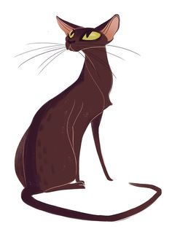
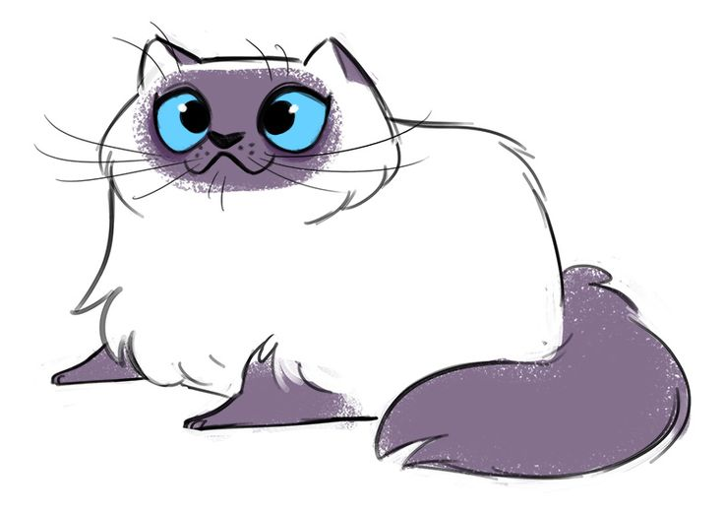
2)
SOUND 1:
SOUND 2:

Slide 7
Which image belongs to SOUND 1?
Which image belongs to SOUND 2?

Slide 8
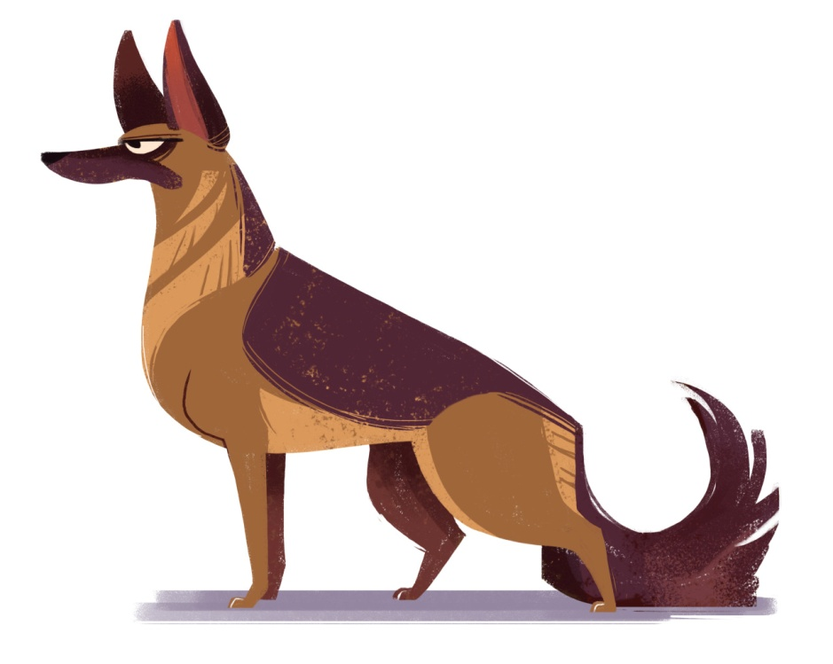
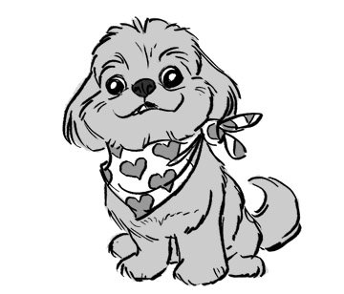
3)
SOUND 1:
SOUND 2:

Slide 9
Which image belongs to SOUND 1?
Which image belongs to SOUND 2?

Slide 10
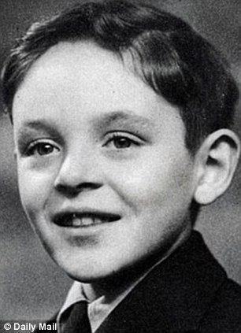
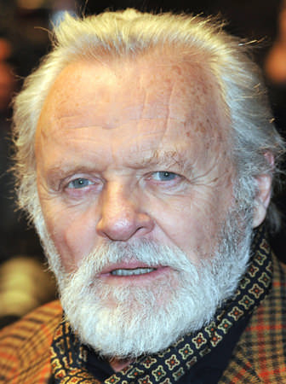
4)
SOUND 1:
SOUND 2:

Slide 11
Which image belongs to SOUND 1?
Which image belongs to SOUND 2?

Slide 12
THANK YOU!

